Slide 1
Follow the Money
The role of Money in the American Electoral System

Slide 2
“Money is the mother’s milk of politics.”
The Watergate Scandal of the 1970s
- political corruption
- illegal campaign contributions exposed
Federal Election Campaign Act passed, 1974
I Federal Election Commission
> administers campaign finance laws
> enforces compliance
II Presidential Election Campaign Fund
> gives money to qualified presidential candidates
> $3.00 option on all individual tax forms (11%
participation)

Slide 3
Federal Election Campaign Act continued…
III Partial funding for presidential primaries
> open to candidates who raise $5,000 in
at least 20 states on their own
> gov’t provides matching funds for all
donations $250 or less (matching funds)
> candidates who accept must agree to
spending limits prescribed by law
> most candidates refuse partial funding
Bush & Kerry (2004); McCain & Obama (2008):
ALL REFUSED!!!

Slide 4
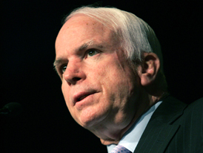
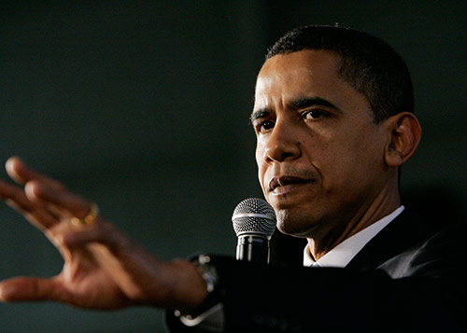
Federal Election Campaign Act continued…
IV Public funding for major party candidates
in general election
> FEC pays cost of general election campaigns
> 2008 limit: $84 million
(McCain accepted…why? And with what result?)
* McCain raised $350 m ($266 m spent on
primary; $84 m spent on general election)
* Obama declined; raised total of $639 m (for
both primary and general elections); spent
approximately $576 m in general election

Slide 5
Federal Election Campaign Act continued…
V Required Full Disclosure
- all candidates must file reports w/FEC
listing contributions and spending
- reports must also disclose who donors
are
VI Limited Contributions
- individuals limited to $1,000 donations
- limit will be increased under McCain-
Feingold Act…

Slide 6
Loopholes to FECA rules…
Buckley v. Valeo, 1974
- allowed candidates unlimited campaign
contributions to their own campaigns
FECA Amendment, 1979 (soft money)
- unlimited contributions allowed for:
1. voter registration drives
2. campaign materials @ grassroots level
3. generic party advertising

Slide 7
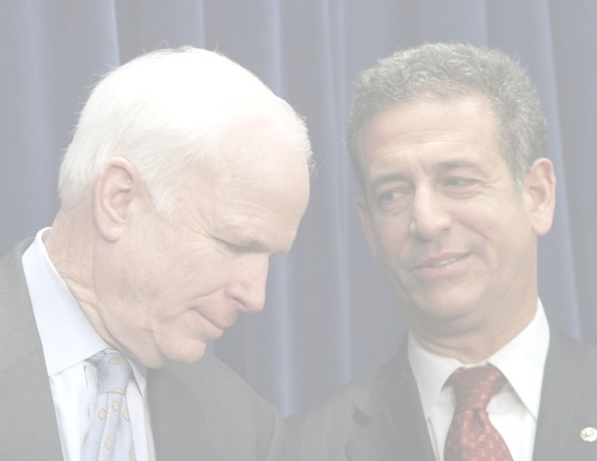
Loopholes continued…
McCain-Feingold Act, 2002
- banned soft money contributions
- individual contributions increased to $2,000
with yearly adjustments for inflation
- barred “issue ads” from within 60 days of
the general election
- replaced the soft money contribution
loophole

Slide 8
Loopholes continued…
527 Groups (named after governing tax code)
- 2004: FEC exempts 527s from contribution
restrictions
- Unlimited contributions to 527s (as long as
they did not explicitly endorse a candidate)
* Swiftboat Veterans for Truth
* MoveOn.org
Political Action Committees
- formed by interest groups, labor & business
- funnel contributions up to $5,000 directly
to candidates

Slide 9
Citizens United v. FEC, 2008
Results:
Removed limits of corporate funding of independent political broadcasts in candidate elections
Limits violated free speech of corporations (expansion of “personhood” of corporations beyond that of individuals, who are limited to $5,000)
In sum, corporations – society’s wealthiest members – have expanded rights not granted to individuals to fund independent groups – SUPERPACS!

