Slide 1
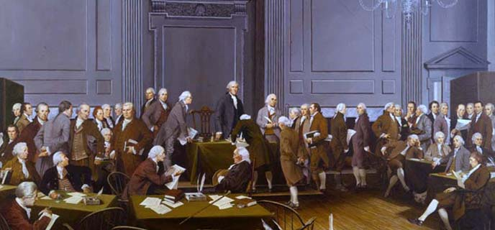
The Great Debate
The Road to Securing Our Fundamental Rights

Slide 2

The debate over federal power…
Federalist Arguments…
Antifederalist Arguments…
powers granted to the national government would correct the problems of the Articles of Confederation
State sovereignty must give way for the general welfare of the nation
federal power was defined and limited, and states still held many residual powers
the truly important powers to govern had been delegated to the national government
states had little role other than to oversee the selection of federal officials
the “necessary and proper” and “supremacy” clauses rendered ineffective any limitations on the powers of the national government

Slide 3
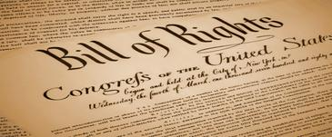
Primary Argument of the Antifederalists…
There is no Bill of Rights!
Federalists first stated that none was needed!
  Powers to take away the rights of the people had not been included in the plan of government…
  Antifederalists laughed heartily and dug in.
Federalists responded with a promise to add a Bill of Rights as first order of business
Result: growth of support for the new government, then ratification

Slide 4
The Bill of Rights
Designed to address the kinds of abuses suffered under British rule
Summarized under the following three concepts:
  Protection of fundamental liberties
  Protection from arbitrary power (rights of accused persons)
  Protection of unnamed rights
Written as the first ten Amendments to the Constitution in 1791

Slide 5
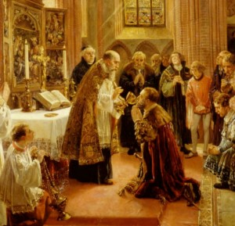
The Bill of Rights – Fundamental Liberties
1st Amendment:
  Freedom of Religion
  Freedom of Speech
  Freedom of Press
  Freedom of Assembly
2nd Amendment:
  Right to bear arms

Slide 6
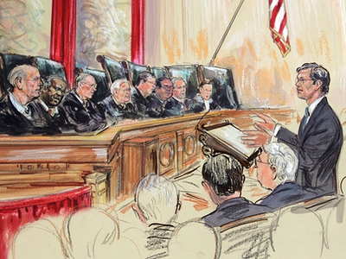
The Bill of Rights – Protection from arbitrary power (rights of accused persons)
3rd Amendment
  No quartering of troops in our homes
4th Amendment
  No illegal search and seizure
5th Amendment
  No capital punishment without indictment
  No double jeopardy
  No forced self-incrimination
  No immanent domain without just compensation
6th Amendment
  Right to speedy& fair trial by jury
7th Amendment
  Right to trial by jury in civil law suits with damages
8th Amendment
  No excessive bail
  No cruel or unusual punishment

Slide 7

Bill of Rights – Unnamed Rights
9th Amendment
  Rights reserved to the people
    These rights are not stated in the previous eight amendments
10th Amendment
  Powers reserved to the states
    If it is not delegated to the United States by the Constitution…
    Nor prohibited to the states by it…
    Then it belongs to the states

Slide 8

Reflection Questions
You will need to access Socrative to answer these questions.
How would you summarize the Bill of Rights to a friend?
What is the most important Amendment in your opinion? (JUSTIFY YOUR ANSWER!)

Slide 9
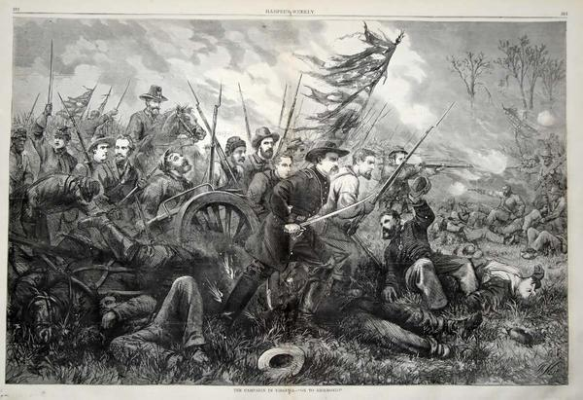
Everyone’s Rights protected since 1791?
Bill of Rights were ignored at the state level…
  Citizenship in states vs. U.S. citizenship
  Bill or Rights seen as protection on the federal level only
Rights of marginalized people routinely ignored by the states
CIVIL WAR: 1861-1865
13th Amendment freed slaves, but still faced discrimination in the states
Revealed flaw in the system of protection of rights!

Slide 10

Incorporation Doctrine
How can we get the Bill of Rights to apply to states as well as the United States?
14th Amendment ratified in 1868
    “No State shall make or enforce any law which shall abridge the privileges or immunities of citizens of the United States; nor shall any State deprive any person of life, liberty, or property without due process of law…”
Impact? States must respect the rights and protections of the Bill of Rights!
This is the incorporation doctrine!

Slide 11
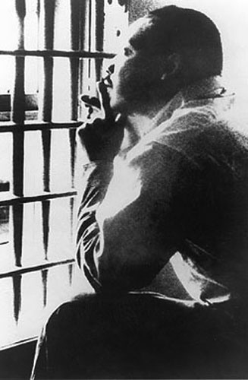
Legacy of Incorporation?
Enlargement and definition of civil liberties
  Civil Liberties: liberties in the Constitution and Bill of Rights that guarantee protection of…
    Persons
    Opinions
    Property
  …from arbitrary interference of government
  Civil Liberties: restraints upon the government
Enlargement and definition of civil rights
  Civil Rights: government policies that protect individuals from arbitrary or discriminatory treatment by government
    Applies to race, gender, and age

Slide 12
Reflection Questions
You will need to access Socrative to answer these questions.
What is the incorporation doctrine?
Why is the incorporation doctrine so important to you as a citizen of the State of Ohio? (Provide an example to support your answer!)
Which principle of government do the Bill of Rights most fully embody?

